Slide 1
Integrated Program Management
Travis Stoner – Hexagon PPM, GBD – Projects Performance

Slide 2
Agenda
Using earned value principles to improve forecasting for all projects
Typical challenges and gaps in an organization’s program management landscape
The building blocks of Integrated Program Management
The path to greater efficiency and accuracy, regardless of project type (e.g. FFP, IDIQ, IR&D, etc.)
Case Studies of organizations leveraging technology to achieve IPM for all projects

Slide 3
Take-Aways
Practice EVM “right sized” as part of IPM
A common portal is key to involving all stakeholders
Commitments are key for understanding material variances
Technology is here to help the People and Processes
Report by Exception

Slide 4
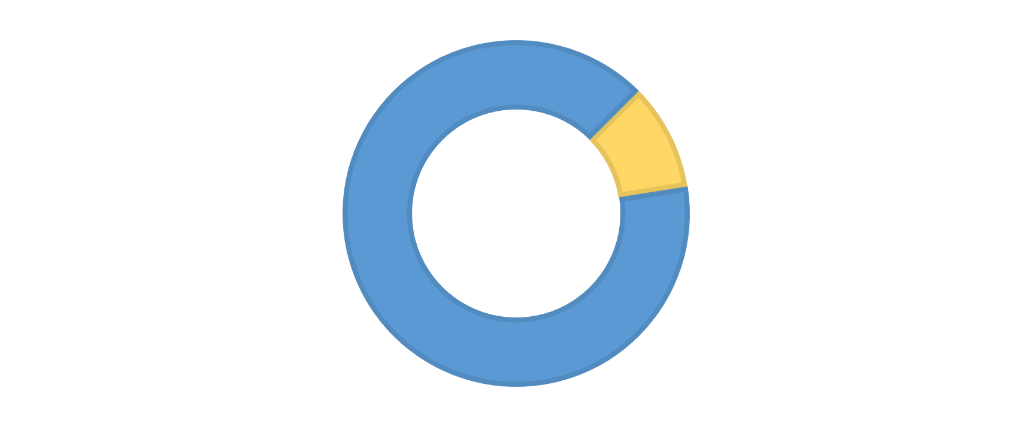
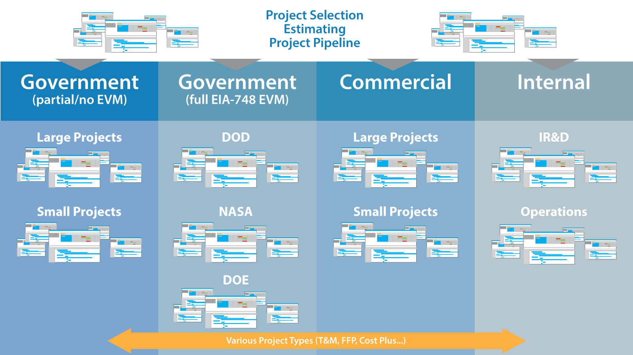
Prototypical Portfolio
Contracts with Formal EVM
~5%
~95%
Some or no EVM Requirements
Notes:
Government Contractors have even more unique challenges. There is a common customer for government contractors that has some pretty stringent management and reporting rules. But these rules typically only apply to a small portion of the project portfolio. A few examples of companies you might know, in 2015 CH2M had $763m in fed contracts and overall sales of $5.3b. General Dynamics had $13.7b in fed contract revenue with overall sales of $31.4b. This is due to many different reasons ranging from the type of contract (Cost Plus, Fixed Price), the dollar amount (under $100m in the US), or the project profile (R&D vs IDIQ vs Construction) as well as Commercial aspects to their business.

Slide 5



What is the importance of EVM?
Cumulative Cost
BAC
CV
(Cost Variance)
PV (Planned Value)
SV
(Schedule Variance)
AC
(Actual Cost)
EV
(Earned Value)
Right Now
Time
Notes:
EVM allows you to visualize what being 50% complete means in relation to actual costs and schedule.
The true benefit of EVM here is that it allows the user to understand the relationship between cost and schedule to a project, allowing more informed decision making and, with regular project updates, allowing the user to distinguish between minor, expected fluctuations in a project and discrepancies that deserve attention.
As an example, let’s say the neighborhood kids have contracted out to me to build a lemonade stand. They’re going to pay be $100. And I figure it will take me 2 hours. I have my project S curve graphed. I’ve never done any carpentry, but how hard can it be?
At some point you stop to check in on your progress. Where the line meets the S curve is the “planned value” for that point, how much you think you will have completed, and how much you will have spent.
In my case, I haven’t completed as much as I had planned. I can’t find tools, I cut things wrong, I had to make trips to the hardware store, watch youtube videos on carpentry…
Earned Value is the reality check of progress. This is what I’ve produced for the time put in so far. The difference between EV and PV is Schedule Variance. As Erik will show you in the demo later, you can decide when this variance is too big and it can trigger alerts.
But that doesn’t tell you the whole story. Are you just starting some things late, or are you throwing away money to get nowhere?
In this case, the actuals are much higher than was anticipated. Not only have you gotten less done, but you’ve spent more money to do it. This is the cost variance. I didn’t just take longer, as I mentioned above, I also spent money I hadn’t anticipated, $8 for a new hammer. Very possibly a trip to urgent care.
At this point I’m wishing I hadn’t just gone and gotten the Ikea version that you put together with that little wrench. Citronsaft.
This is useful information, but it’s actually a bad example of EVM, because it’s most useful at the very beginning of a project, and here’s why.

Slide 6
What is the importance of EVM?
EAC
(Cost) Variance at
Completion
Cumulative Cost
BAC
Projected Project Delay
CV
(Cost Variance)
PV (Planned Value)
SV
(Schedule Variance)
AC
(Actual Cost)
EV
(Earned Value)
Right Now
Time
Notes:
At 20 percent completion, you can leverage EVM to create a forecast that’s accurate to within 10 percent of final costs. Giving you a clear picture of what will happen, both costs and schedule, if you stay on course.

Slide 7
So Why Not EVM?
Record Direct Costs
Define WBS
Summarize Costs in WBS
Identify the Organization
Accounting
Summarize Costs in OBS
Integrate Subsystems
Organization
Record Indirect Costs
Identify Overhead Controls
Identify Equivalent & Lot Costs
Integrate WBS and OBS
Perform Material Accounting
EIA-748
Guidelines
Periodically Collect Control Account Sums
Determine Variances
Schedule Work
Analysis
Budget and Actual Indirect Costs
Identify Products & Milestones
Sum Data and Variances
Set Time-phased budget
Manage Action Plans
Identify Significant Cost Elements
Revise EAC
Establish Discrete Work Packages
Planning & Budgeting
Sum Work and Planning Packages
Incorporate Changes
Identify Level of Effort Work
Revisions
Reconcile Budgets
Set Overhead for Organizations
Control Retroactive Changes
Identify Management Reserve & Unallocated Budget
Only Authorized Changes
Identify Target Costs and Budgets
Document PMB Changes
Notes:
So based on that, why wouldn’t anyone want to adopt EVM?
We think one of the reasons it hasn’t gained as much traction as it should, is because EVM is often conflated with rules for government compliance, for example the EIA-748 guidelines for DoD projects of $100M USD or greater.
This is the only situation where the level of rigor shown here is required. It is not representative of EVM, and it’s not necessary for an organization to effectively adopt EVM. In fact the level of detail required often prevents EVM from being applied as an effective cost management tool. It becomes an exercise of compliance.

Slide 8


The Pillars of EVM
ETC
EAC
Baseline Work Packages
Scope
Budget Over Time
Progress Data
Actual Costs
Project
2017 EVMP Forum – August 24th & 25th
Notes:
EVM adds process standards and performance metrics to a project controls framework. It does not and cannot exist separately. It builds on what you have.
For EVM to function effectively, you need four solid “pillars” of project data for it to build on.
Scope -- The key here is finding the right level of detail, and Keith will talk more about that.
Budget over Time – just like work planned vs. work completed, you need to have a clear understanding of when you expect to spend money.
Progress – you want to compare work completed against work planned, so progress is critical. When was this supposed to get done?
Actuals --
Once EV Metrics are available, they in turn, can help form additional forecast models.
An EVMS supporting multiple formulas for Estimate At Complete.
The most appropriate method can then be selected to revise forecasts or initiate changes to the project execution.

Slide 9

Scope
Advanced
High level design
WBS Dictionary
Scope
Intermediate
Develop a WBS
Detail important areas
Basics
Keep it high level!
Define the effort.
2017 EVMP Forum – August 24th & 25th

Slide 10
Budget over Time
Advanced
Resource-loaded schedule
Budget over Time
Intermediate
Define time frames w/ sched
Add’l time-phasing methods
Basics
Hours or direct costs
Linear time phasing
2017 EVMP Forum – August 24th & 25th

Slide 11
Progress
Advanced
Milestones, Backup Data
Workflow for work owners
Progress
Intermediate
Up-front Quantitative Measurements
Basics
Percent complete
2017 EVMP Forum – August 24th & 25th

Slide 12
Actual Costs
Advanced
Hours/dollars at work package level
Actual Costs
Intermediate
Detail targeted areas
Basics
High level hours/dollars
2017 EVMP Forum – August 24th & 25th

Slide 13
Work Packages
Advanced
Workflows for change approvals & e-signature
Work Packages
Intermediate
Capture Change Approvals, Formal change tracking log
Basics
Incorporate Changes
2017 EVMP Forum – August 24th & 25th

Slide 14
Additional Maturity Considerations
Work Authorization
Explanation of Variance/Recovery
Commitments
Forecasting
Budget Burdens

Slide 15
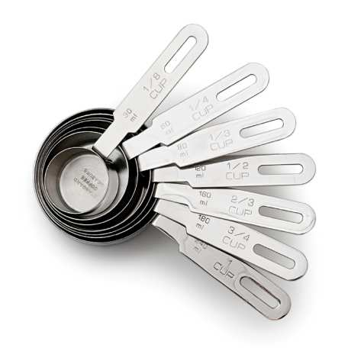
EVM Right!
Right-sized EVM can be achieved with:
Establishing a solid platform for budgeting, forecasting, change management.
Defining EVM approach appropriate for contract type, project size, and/or discipline
Scoping to the appropriate level of management and control
Performing accurate and timely Progress Measurement based on standard templates and approaches.
Pulling from an integrated source of Actual Costs
Ensuring change management integrated into EVM
Matching terminology to organization culture
(ex: “CPI”, “Earned/Burned”, “Productivity”)
Notes:
Effective EVM is not a “one size fits all” approach. How an organization ought to implement it depends on the needs of the projects and the needs of the organization. Given this, how do you apply the “right amount” of EVM? What is the minimum EVM before we’ve stripped out too much detail? The following elements should be achieved:
Build a solid platform for budgeting, forecasting, and change management.
Use templates for WBS and progress measurement rules.
Standardize reports and views for periodic and cumulative trends.
Match EV terminology to the culture of an organization to make it accessible, user-friendly, and better understood. CPI can instead be named “Earned/Burned” or “Productivity.” Avoid the burden of using the ANSI standards when an organization has already developed its own processes and expertise.
Create a full project performance picture. This means monitoring non-EV key performance indicators (KPIs) in conjunction with EV metrics.
Develop EV metrics on a cross-section of data as appropriate – not just costs, but also hours or quantities. Then be able to roll up EV accordingly.
Document variance analysis and justification. Reporting on trends and variances alone is insufficient. Having a central record of why variances are occurring provides a stronger tool for current and future performance improvements.

Slide 16
Learning Objectives
Standards
Coding
Collaboration / Integration
Program Management

Slide 17
Firms tend to use multiple software platforms that are manually monitored and disconnected, which severely compromises their effectiveness.
Geno Armstrong
International Sector Leader,
Engineering and Construction
KPMG
Notes:
Technology is the weak link. KPMG report says that organizations tend to have very well developed processes in place but the supporting technology is holding them back.

Slide 18
Disconnected People & Systems
Access to Real-time Project Data?
Owners
Contractors
Fully Integrated Project Controls System?
KPMG: Global Construction Survey
Notes:
KPMG survey
75% of owners, 74% of contractors do not have real-time access to project data.
20% of owners, 21% of contractors have fully integrated project controls systems.

Slide 19


Disconnected Systems & Manual Processes
Tedious Labor
Departmental
Budgets
Project Budgets
AFEs
/Funding
Procurement
?
PROGRESS & PERFORMANCE
Mistakes
$
$
Version Control
Project Forecasts
Design & Engineering
Construction
Finance
Notes:
When project data is not integrated, it takes a tremendous amount of manual effort to put it together for practical use. Downloading files, formatting, etc.
This requires tedious labor, leaves projects vulnerable to mistakes, and creates version control issues.
It can take the greater part of a day to produce a single project cost report.

Slide 20
The Burden of Low-Value Work
Relying on Manual Processes:
61% Of time utilization
Fixing ERP issues and Labor coding
Downloading files and collating
Internal study done by EcoSys client prior to implementation
Notes:
Internal study done by EcoSys client prior to implementation

Slide 21
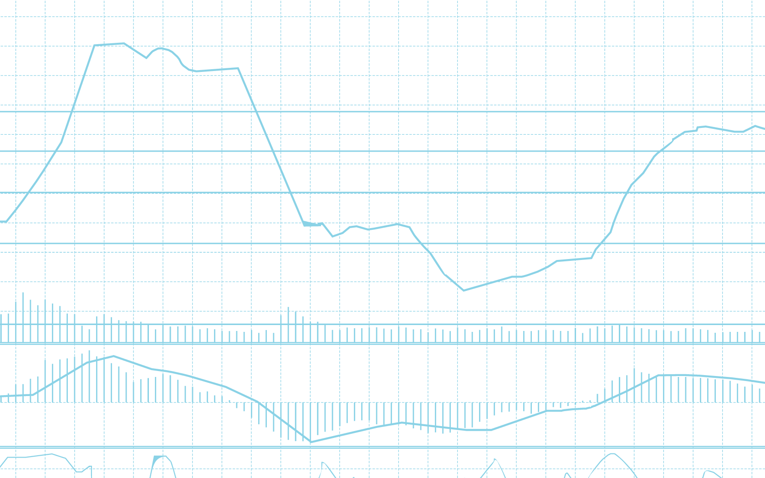
Disconnected People & Systems
What do we expect our final costs to be?
Visibility Challenges
Who approved this change and why?
Schedule Data
Documents, Contracts
Which projects are underperforming and why?
Cost Data
Communications, Changes
Notes:
Because there is no centralized source of information, it’s difficult to know how to get answers to fundamental questions.

Slide 22
Disconnected People & Systems
Can’t identify issues
Can’t make adjustments
Can’t anticipate needs
Can’t plan effectively
NEW
OLD
Projects Cost More
Projects Take Longer
$
Notes:
Difficult to identify issues
Difficult to steer projects back on track
Difficult to anticipate resource/cash needs
Difficult to implement strategic planning
So:
Projects cost more.
Projects take longer.
And the effect snowballs. Project performance impacts future project readiness.

Slide 23
What is Integrated Program Management?
Optimizing Project Performance & Efficiency
Strategic Planning & Project Selection
2017 EVMP Forum – August 24th & 25th
23
Notes:
We’ve talked in previous webinars about the challenge of a cost/schedule divide, where different systems manage different sets of information. There is a similar sort of divide between the tactical, day to day management of project controls and the strategic, high-level management of project portfolios. Enterprise project controls is the creation of a feedback loop between the two, where project performance helps to inform selection and planning, which in term helps to ensure that the right projects are executed at the right time, ensuring better performance.

Slide 24
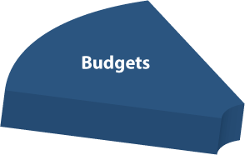
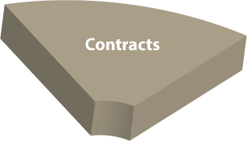
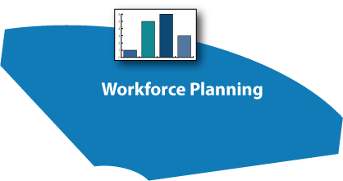

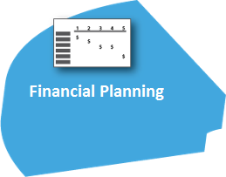
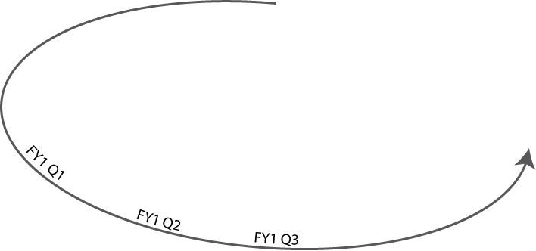
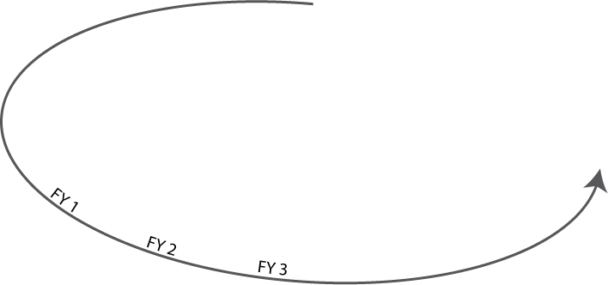
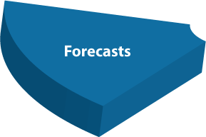
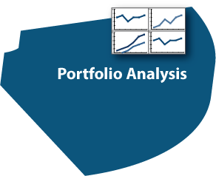
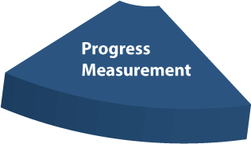
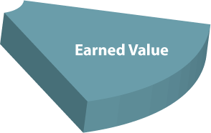
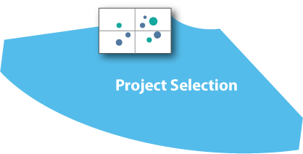
What is Integrated Program Management?
Comprehensive tools and processes for effective tactical project execution
Controls for strategic planning and portfolio optimization
Notes:
Comprehensive tools for tactical project execution
Plus controls for strategic planning, portfolio optimization

Slide 25
What is Integrated Program Management?
Consistency
in project planning and execution
Approved Projects
Resources
Budgets
Visibility
Actuals
Forecasts
Performance
into all project data
Alignment
of enterprise level strategy and day-to-day execution
Notes:
A connection between the two levels
Consistency in project planning and execution
Visibility into all relevant project data
Alignment of enterprise-level strategy and day-to-day execution

Slide 26
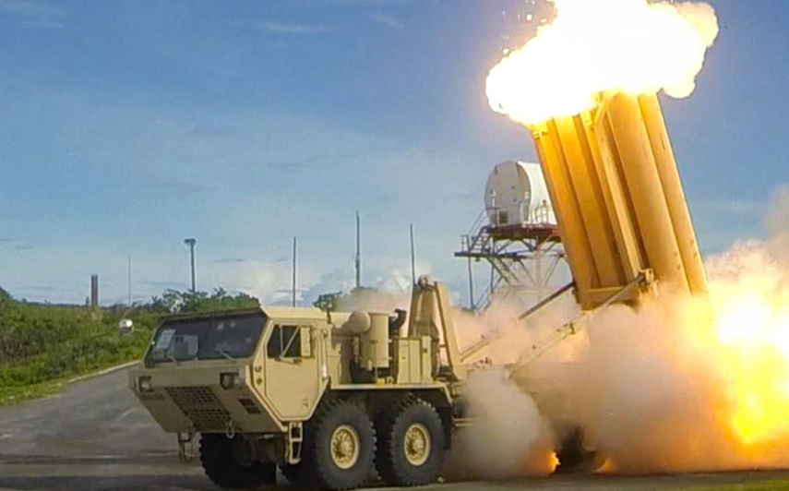

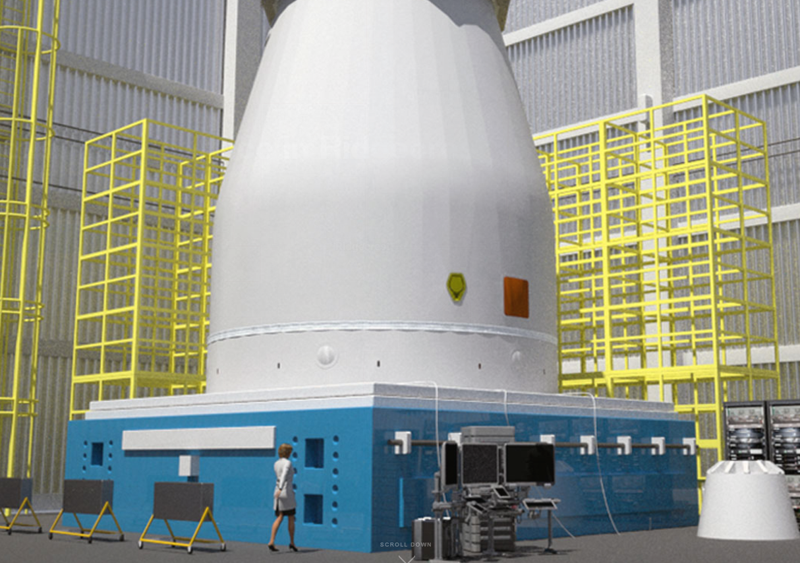
Industry Trend
Industry leaders are embracing Integrated Program Controls processes & tools
Planning and execution of all projects with consistent processes
Visibility of project health, issues, status, and financials
Active collaboration with all project stakeholders
Effective decision making based on the latest information
Provides project based companies with better internal controls for financials
Notes:
Project based businesses have unique challenges. They continuingly operate on efforts that are unique, can have a ton of risk, have large manpower and material needs, and generally have many unknowns involved. In contrast, companies that create and sell a product do the same thing repeatedly, with arguably less risk. Now, I am not saying that all business does not have risk but I am saying that I think that a business that runs projects, continuingly doing things that have never been done before, these companies need better controls and processes to manage their business. Companies that do not have good control end up in the news because they are missing their revenue or profit projections or even worse restating their financials due to a material weakness of internal controls over financial reporting.

Slide 27



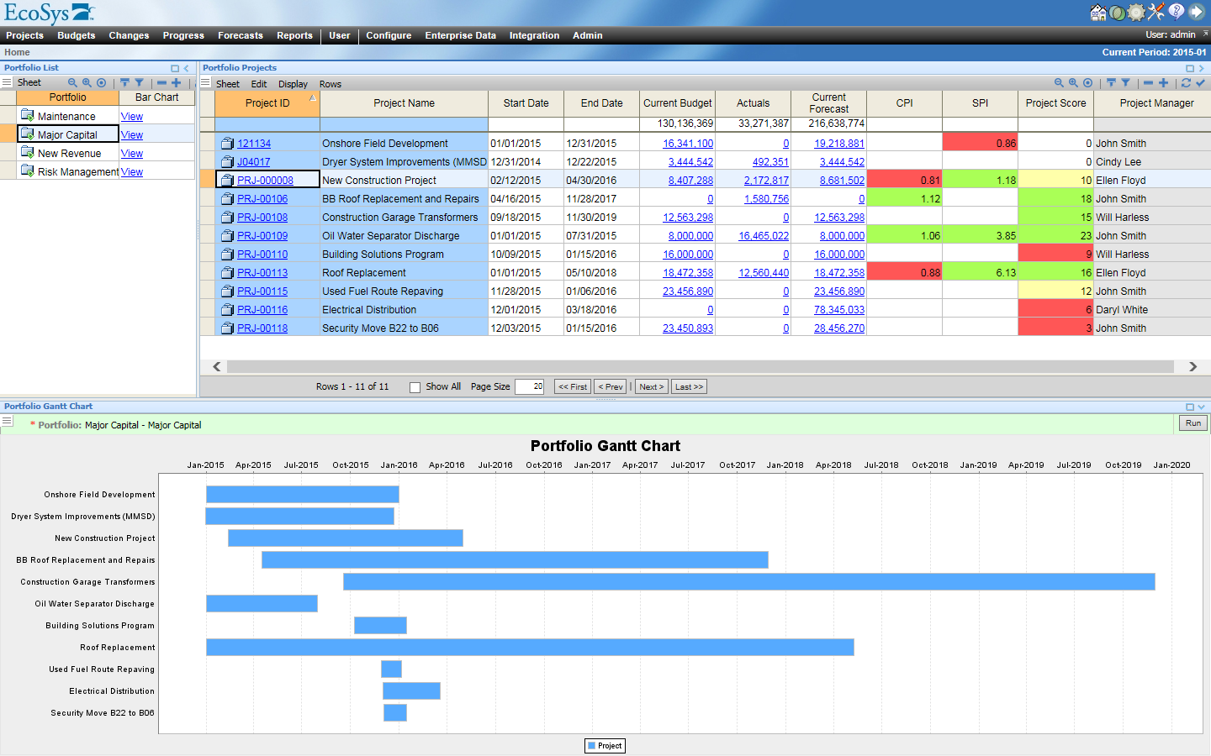

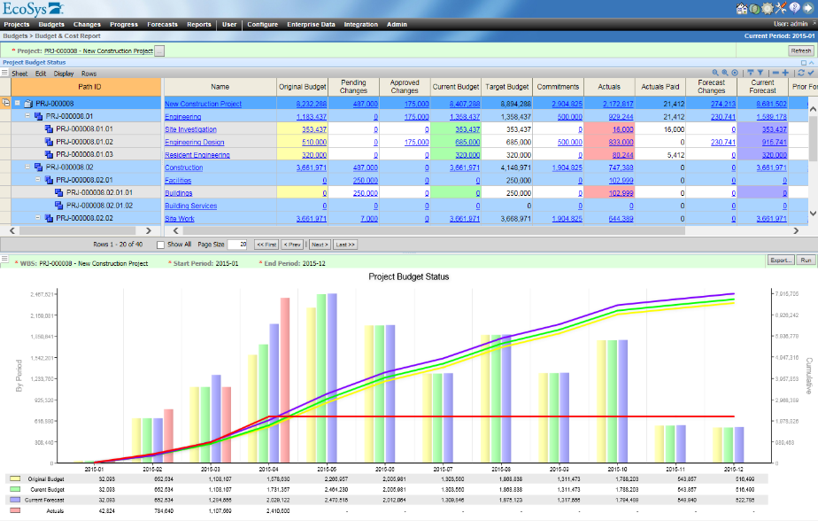

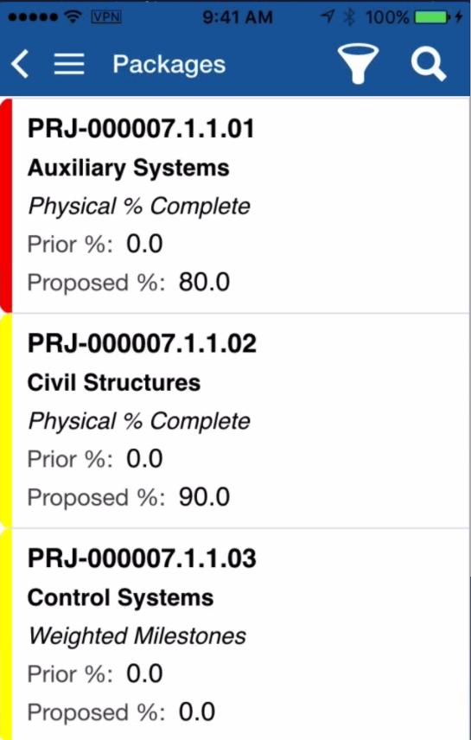
Business Friendly Design
Tailored User Experience
Control Account Manager
Program Finance
Portfolio Manager
Collaboration
Filtered Information

Slide 28
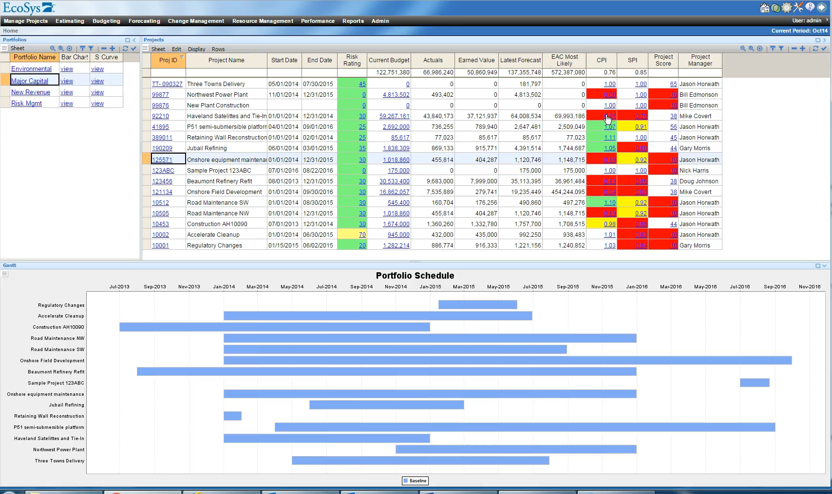
State of the Art Solution
Off-the Shelf, Configurable
Graphical Charts & Dashboards
Dynamic Business Intelligence
Drill-Down to Any Level of Detail
Output to Multiple Formats (PDF, Excel, Word, XML)
Automated and User-Initiated Reporting
Browser based for end users

Slide 29

The Impact of Integrated Program Mgmt
Increased Efficiency
Improved Cost Performance
Accelerated Revenue

Slide 30
Efficiency Gains
Low-value work
A Single Source of Integrated Data
Automated Reporting and Alerts
Right-sized Processes
Templates
70% – 80% increase in productivity

Slide 31
Improved Cost Performance
Portfolio Optimization
    “Choosing the right combination of projects and eliminating wasteful ones” leads to savings of 7.4% of project spend
    “Proper structuring, monitoring and enforcement of contracts leads to 9% savings on contract values”
    With low use of change management, average cost growth is 10.2 %
    With high use of change management, average cost growth is -1.2%
Contract Management
Change Management
  - Construction Industry Institute, “CII Best Practices Guide: Improving Project Performance”
  McKinsey, “Infrastructure Productivity: How to Save $1 Trillion a year”, January 2013
  - International Association of Contract and Commercial Management (IACCM)
Notes:
To do: add graphic below illustrating how the listed % would impact portfolio spend suggesting ROI.

Slide 32

Fully Integrated Project Data
i
i
Departmental
Budgets
Project Budgets
AFEs
/Funding
Procurement
AUTOMATED INTEGRATIONS
?
PROGRESS & PERFORMANCE
i
i
$
Project Forecasts
Design & Engineering
ENTERPRISE PROJECT CONTROLS
Construction
Finance
REAL-TIME VISUALIZATION
Notes:
EcoSys EPC breaks down silos, bringing in all project data.

Slide 33


Ball Aerospace
Headquarters: Broomfield, Colorado
Top Objectives
To gain continued recognition for excellence in project execution – a necessity for success in the complex engineering world of satellites, spacecraft and their affiliated systems.
Continuous improvement of internal processes and systems in order to drive project excellence and ultimately satisfied customers and profitable operations.
Standardize data at an enterprise level, and spend more time doing value-added analysis.
Industry: Aerospace & Defense
Employees: 2,800
Software Use: United States
Resolution
12
Selected EcoSys as an enterprise solution to manage program costs across company.
EcoSys replaced existing estimating and pricing systems and replaced or consolidated multiple existing Ball software systems to supply integrated program management and business management processes and systems.
Ball can report and analyze program data in a consolidated fashion, and at deeper level than before.
Systems replaced by EcoSys EPC
Additional Info
Key Benefits
Eliminated complexity
Leveraged Ecosys’s flexibility to match existing, proven business processes
Realized greater insights to predict and improve outcomes on active projects, while achieving the flexibility and intelligence to adapt long-term strategy at the program/organizational level over time.
Ball has been able to develop new metrics to help assess what is driving their business.

Slide 34



FROM JARS
TO STARS
Some know us for the glass jars that bear our name.
Some know us for metal packaging for food, beverage and consumer goods.
Some know us for ground-breaking aerospace and defense solutions.
All our customers know we are there to help them succeed – no matter the challenge or mission.

Slide 35
Ball Finance
Accounting
Government Accounting & Compliance
Contracts
Project Controls
Financial Planning & Analysis
Cost Estimating
SBU Reporting and Analysis
Budgeting
Fee Accrual Analysis
Change Control
Opportunity Management
Scheduling
Resource Planning
Risk Analysis
Program Planning
Life Cycle Management
Earned Value
Finance Organization provides support to
4 Business Units and ~ 400 Active Programs

Slide 36
Tool Overview Prior to EcoSys
Each cylinder represents a separate tool.
Interfacing existed, but no Integration.
Actuals
Program / Proposal Estimates
Contract Data
Opportunity Tracking
Fee Accrual Tracking
Consolidated Reporting
(Costpoint)
Resource Data
Earned Value
Pricing Rates
Program Life Cycle Mgmt
Risk Mgmt
GPS
MPM
IRIS
Off-The-Shelf
Home Grown

Slide 37
Vision for Future
Program Life Cycle Mgmt
Actuals
Contract Data
Resource Data
Resource Planning
Consolidated Reporting
Costpoint
GPS
EcoSys
Program / Proposal Estimates
Phase 1: Estimation and Pricing
Fee Accrual Tracking
Pricing Rates
Phase 2: Forecast Management
Phase 3: Performance Management
Phase 4: Execution Management
Opportunity Tracking
Earned Value
Risk Mgmt

Slide 38
Current Configuration Overview
Configuration
Actions: ~3700 (Batches: ~700)
Spreadsheets: ~1600
Reports: ~800 (Batches ~70)
Formulas: ~1600
Screen Layouts: ~400
Forms: ~150
Charts: ~30
Menus: ~125
Custom Fields: ~200
Category Fields: ~170
Resource Planning
Consolidated Reporting
Detailed Estimating / Reporting
Usage
Versions: ~170
Cost Objects: ~390,000
Actual Transactions: ~13.3M
Working Forecast Transactions: ~94M
Users: ~530
Portfolio Dashboards
Configuration Optimization
Fee Accrual Mgmt
Variance Analysis
Opportunity Mgmt
Earned Value
Phase 1: Estimation and Pricing
Phase 2: Forecast Management
Phase 3: Performance Management

Slide 39
Efficiencies Gained
Only system at Ball that automatically integrates Actuals, Forecast, and Budgets.
Simplification of Pricing Rate Updates
Configuration Updates do not require IT support
Integration of external metadata is automated
  Resource (GPS) Information
  Contracts System Information
  Program WBS Information (Costpoint)
Eliminates need for server surfing for the correct data

Slide 40
Lessons Learned
Requirements Definition
  Struggle to get “Desired Output” vs “This is exactly how the Current tool works”
Cultural Issues
  Difficult transition for end users used to using MS Excel who have no stake in consolidated information
  Analysts are rewarded for being able to take data out of various systems and present data custom configured to their programs’ desires.
Amount of data
  Original design did not anticipate the amount of transactions/wbs elements that would be involved.
  Original design did not anticipate amount of data that would be pulled with single reports.
    We’ve spent a lot of time, and still have future plans for data summarization to optimize reporting.
Simplification of Design
  EcoSys Software is easy to use, but original design included functions for every requirement ever listed. Everybody wants to do it different. Many functions needed to be simplified to allow infrequent users an opportunity to survive. This however increased the amount of configuration required since will still need to support the one-off desired functionality.

Slide 41
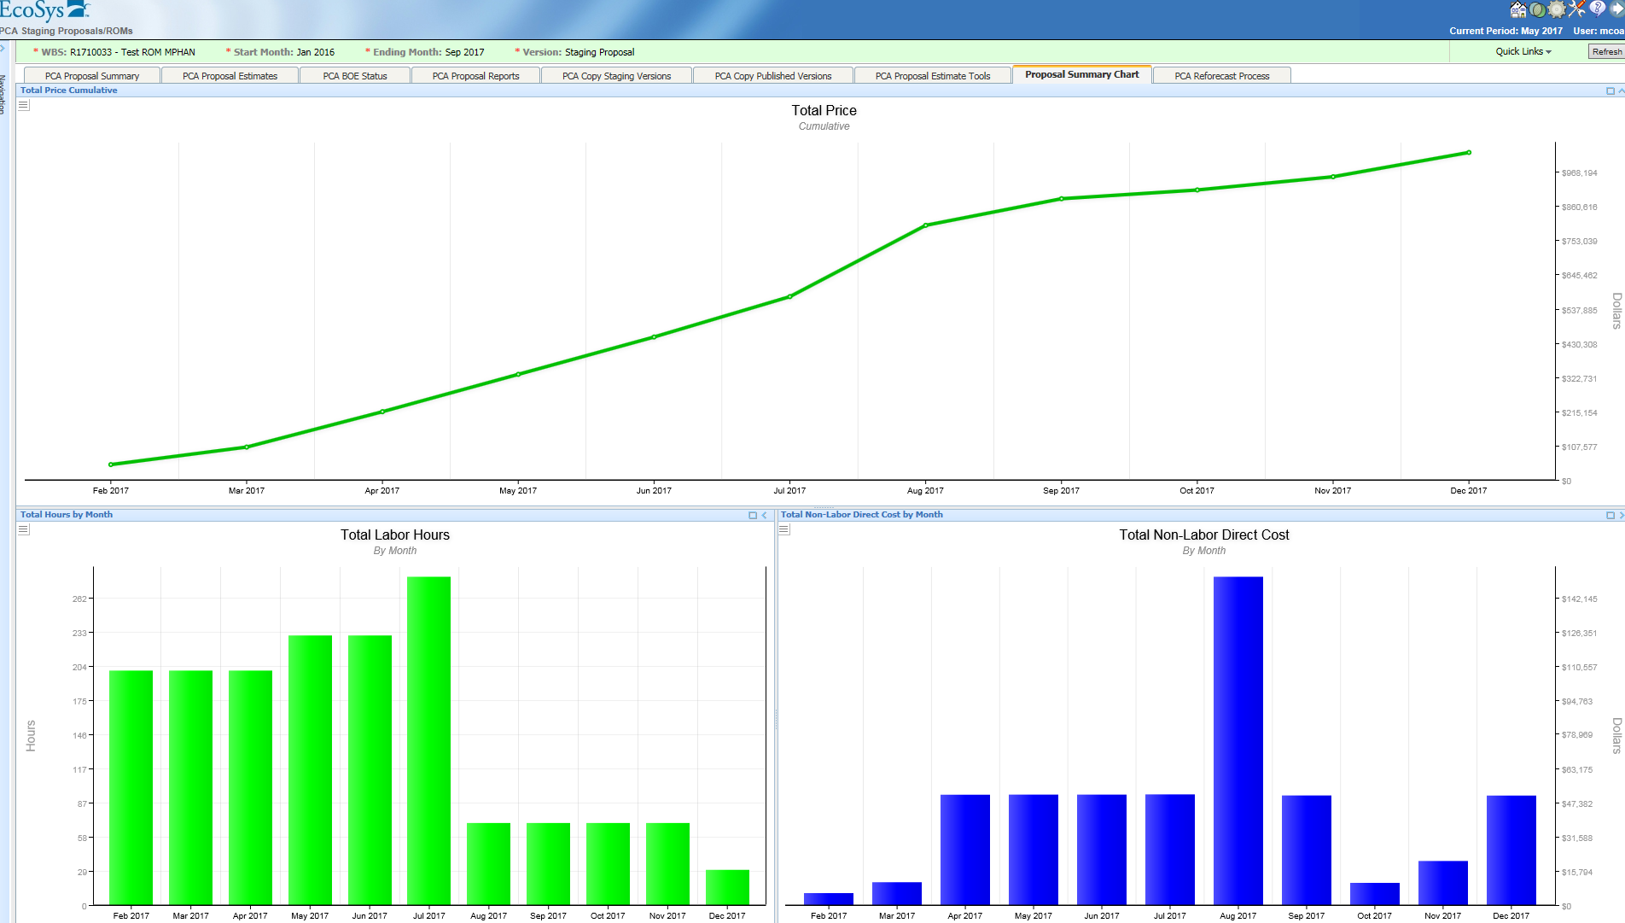
Improved CHART functionality is allowing for better visualization directly in EcoSys.

Slide 42
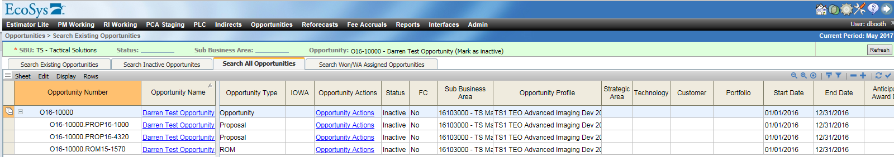
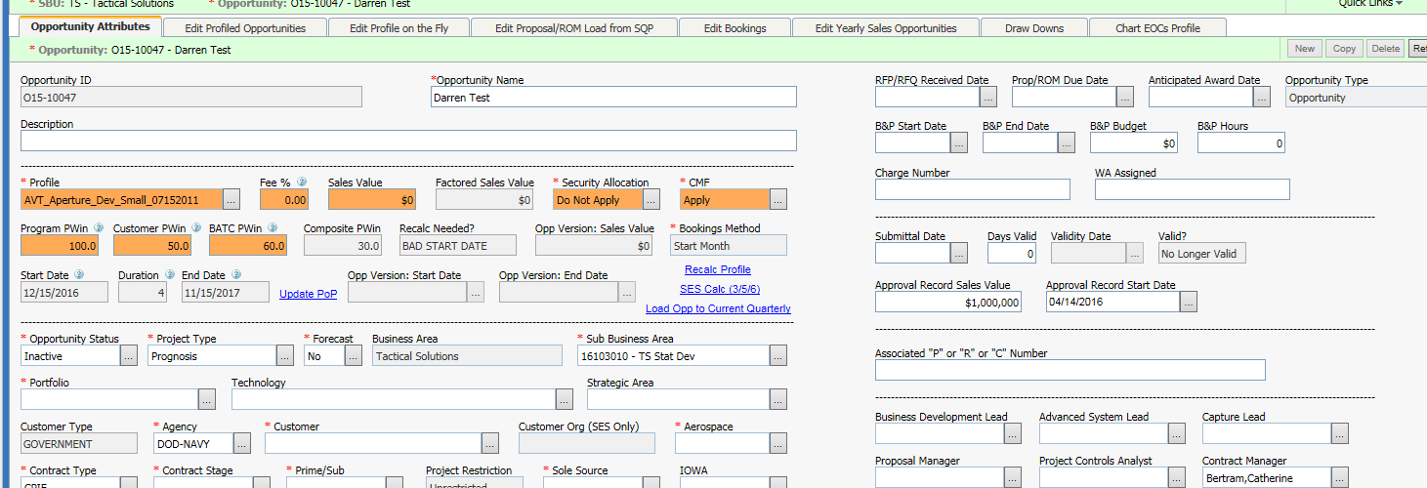
OPPORTUNITIES Module: Allows us to track history of Opportunity as it progresses from Pursuit, to Request for Proposal, To Contracted Program. The ability to use the COST OBJECT field for multiple purposes allows this.
Opportunity metadata helps with metrics, reporting, etc.

Slide 43
Goals for Future
Leverage Charting functionality in EcoSys to drive more executive/director level personnel to capture data directly from database.
Leverage Workflow functionality to reduce work being done “outside” of the system
Leverage existing resource estimate and Workflow functionality to provide personnel managers with forward planning data
Move “Estimators” as close as possible to the end product

Slide 44
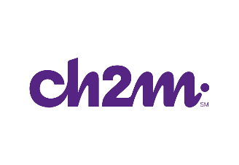

CH2M
Headquarters: Englewood, Colorado
Top Objectives
Effectively manage more than 3,000 projects across a range of industries.
Create data set to identify issues and organizational behaviors in order to inform new set of best practices and raise the bar for project execution across the market.
Standardize project controls to prevent business units from using disparate project delivery systems and spending money on point solutions that couldn’t be replicated.
Find a tool flexible enough to meet current needs and help them build into the future.
Industry: EPC, GovCon
Employees: 26,000+
Software Use: Global
Resolution
5,000
After in-depth industry search, CH2M selected EcoSys for its high configurability and for the industry expertise that EcoSys provides.
Leveraging EcoSys for capital project management, portfolio management, earned value, progress measurement, contract changes, and eventually resource management as well.
Interfaces with Oracle ERP system, internally developed estimating tool, and Business Intelligence system.
Clients in
50+ countries
Additional Info
Key Benefits
EcoSys is a competitive differentiator for CH2M in the market as it helps them deliver stronger capital projects.
EPC is helping them more intelligently leverage big data and ultimately leading to a whole new set of capabilities around gathering new insights, making smarter business decisions, and developing transparency into their business.

Slide 45

Thank you for your time! Any Questions?

Slide 46
Agenda
Take-Aways
Introduction
Project Overview
Earned Value Planning Process
Earned Value Executing Process
Earned Value Monitoring and Controlling Process
Challenges
Successes
EVM Takeaways

